Slide 1
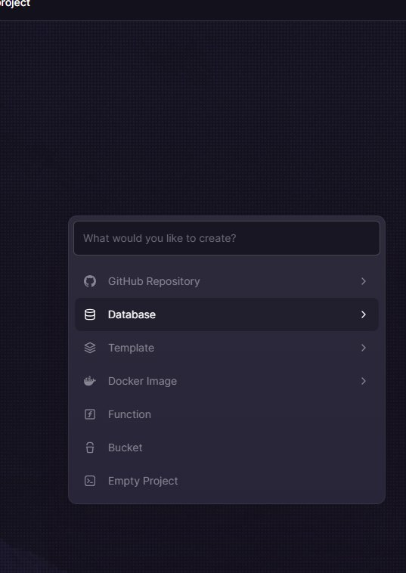
EN
WEEK 01
</>
Variables, Data Types & Logic
Storing information and making decisions in Python
By the end of this lesson you will be able to:
○ Create and assign variables in Python
○ Identify and use the 4 core data types: int, float, str, bool
○ Write simple if / elif / else logic
codencode.my
Python for Beginners • Week 01 — Variables, Data Types & Logic
EN
01

Slide 2
Why Python?
📖 The most beginner-friendly language
hello.py
Python is one of the world's most popular programming languages — used by Google, NASA, Netflix, and thousands of Malaysian companies.
Why Python?
○ Reads almost like English
○ No semicolons or complex syntax
○ Runs instantly — no compiling
○ Used for web, data, AI, automation
Your first program takes 1 line:
print("Hello, World!")
# This is a comment — Python ignores it
print("Hello, World!")
print("Selamat datang ke codencode.my!")
print("欢迎来到 codencode.my!")
# Running this file outputs:
# Hello, World!
# Selamat datang ke codencode.my!
# 欢迎来到 codencode.my!
# Python uses indentation, not {}
# No semicolons needed at end of lines
codencode.my
Python for Beginners • Week 01 — Variables, Data Types & Logic
EN
02

Slide 3
What is a Variable?
📖 Variables store data
variables.py
A variable is like a labelled box.
You give it a name, and put a value inside. Python remembers that value so you can use it later.
Rules for naming variables:
○ Use letters, numbers, underscores
○ No spaces — use_underscores
○ Names are case-sensitive (age ≠ Age)
○ Cannot start with a number
○ Avoid Python keywords (if, for, def...)
# Assigning variables
name = "Aisha"
age = 16
height = 1.62
is_student = True
# Using variables
print(name) # Aisha
print(age) # 16
print(height) # 1.62
print(is_student) # True
# Re-assigning
age = 17 # ← update value
print(age) # 17
codencode.my
Python for Beginners • Week 01 — Variables, Data Types & Logic
EN
03

Slide 4
The 4 Core Data Types
int
Integer
flt
Float
Whole numbers — no decimal.
Examples: 5, -3, 100, 0
Use for: age, score, count, quantity
Numbers with a decimal point.
Examples: 3.14, -0.5, 99.9
Use for: height, price, percentage, GPA
str
String
bool
Boolean
Text — always in quotes.
Examples: "Hello", "Aisha", "123"
Use for: names, messages, labels, user input
Only two values: True or False.
Examples: True, False
Use for: yes/no decisions, on/off flags, conditions
codencode.my
Python for Beginners • Week 01 — Variables, Data Types & Logic
EN
04

Slide 5
Checking & Converting Types
📖 type() and casting
types.py
Use type() to check what kind of data a variable holds.
Sometimes you need to convert between types — this is called casting.
○ int() → converts to integer
○ float() → converts to float
○ str() → converts to string
○ bool() → converts to boolean
⚠️ You cannot add a string and an integer without converting first!
name = "Aisha"
age = 16
gpa = 3.85
# Check types
print(type(name)) # <class 'str'>
print(type(age)) # <class 'int'>
print(type(gpa)) # <class 'float'>
# Casting
score = "95"
print(score + 5) # ❌ Error!
print(int(score) + 5) # ✅ 100
# int → str for concatenation
print("Age: " + str(age)) # Age: 16
codencode.my
Python for Beginners • Week 01 — Variables, Data Types & Logic
EN
05

Slide 6
String Operations & f-strings
strings.py
name = "Aisha"
score = 92
# Concatenation (joining strings)
print("Hello, " + name + "!")
# f-string (modern, recommended)
print(f"Hello, {name}! Your score is {score}.")
# Useful string methods
print(name.upper()) # AISHA
print(name.lower()) # aisha
print(len(name)) # 5
print(name[0]) # A (first character)
print(name[-1]) # a (last character)
# Repeat and check
print("ha" * 3) # hahaha
print("ish" in name) # True
💡 What this does:
f-strings are the cleanest way to embed variables inside text. Write f"...{variable}..." — Python fills in the value automatically. Much cleaner than + concatenation.
codencode.my
Python for Beginners • Week 01 — Variables, Data Types & Logic
EN
06

Slide 7
Getting Input from the User
input_demo.py
# input() always returns a STRING
name = input("What is your name? ")
age_str = input("How old are you? ")
# Convert to int for calculations
age = int(age_str)
birth_year = 2026 - age
print(f"Hello, {name}!")
print(f"You were born around {birth_year}.")
# Inline casting (common shorthand)
score = float(input("Enter your score: "))
print(f"Score: {score:.1f}%")
# ── Run output ──────────────────────────
# What is your name? Aisha
# How old are you? 16
# Hello, Aisha!
# You were born around 2010.
💡 What this does:
input() pauses the program and waits for the user to type. It always gives back a string. Use int() or float() to convert when you need numbers for calculations.
codencode.my
Python for Beginners • Week 01 — Variables, Data Types & Logic
EN
07

Slide 8
Arithmetic & Operators
📖 Math in Python
operators.py
Python supports all standard maths operations:
○ + addition (5 + 3 = 8)
○ - subtraction (5 - 3 = 2)
○ * multiplication (5 * 3 = 15)
○ / division (7 / 2 = 3.5)
○ // floor division (7 // 2 = 3)
○ % modulus/remainder (7 % 2 = 1)
○ ** power (2 ** 8 = 256)
Operator precedence: ** first, then *, /, //, %, then +, -.
Use parentheses () to control order.
price = 25.50
qty = 3
tax = 0.06
subtotal = price * qty
tax_amt = subtotal * tax
total = subtotal + tax_amt
print(f"Subtotal: RM {subtotal:.2f}")
print(f"Tax (6%): RM {tax_amt:.2f}")
print(f"Total: RM {total:.2f}")
# Useful shortcuts
x = 10
x += 5 # x = x + 5 → 15
x *= 2 # x = x * 2 → 30
x //= 4 # x = x // 4 → 7
print(x) # 7
codencode.my
Python for Beginners • Week 01 — Variables, Data Types & Logic
EN
08

Slide 9
Making Decisions — if / elif / else
📖 Conditional logic
conditions.py
Programs make decisions with if/elif/else.
○ if — checks the first condition
○ elif — checks another condition (can have many)
○ else — runs if nothing matched
Comparison operators:
== equal to != not equal
> greater than < less than
>= greater or = <= less or =
Logical operators:
and — both must be true
or — at least one must be true
not — flips True/False
score = int(input("Enter score: "))
if score >= 90:
print("Grade: A — Excellent!")
elif score >= 75:
print("Grade: B — Good job!")
elif score >= 60:
print("Grade: C — Keep going!")
else:
print("Grade: F — Let's revise!")
# Combining conditions
age = 17
has_id = True
if age >= 18 and has_id:
print("Entry allowed")
else:
print("Entry denied")
codencode.my
Python for Beginners • Week 01 — Variables, Data Types & Logic
EN
09

Slide 10
Putting It All Together
profile.py
name = input("Name: ")
age = int(input("Age: "))
score = float(input("Test score (%): "))
print(f"
── Student Profile ──")
print(f"Name : {name}")
print(f"Age : {age}")
print(f"Score: {score:.1f}%")
# Nested if
if score >= 80:
status = "PASS with distinction"
elif score >= 50:
status = "PASS"
else:
status = "FAIL — extra support needed"
category = "Teen" if age < 20 else "Adult"
print(f"Status: {status}")
print(f"Category: {category}")
💡 What this does:
Combining input(), casting, f-strings, and if/elif/else into one program. The one-line ternary 'x if condition else y' is a compact way to assign based on a condition.
codencode.my
Python for Beginners • Week 01 — Variables, Data Types & Logic
EN
10

Slide 11
Boolean Logic & Truthy/Falsy Values
booleans.py
# Comparison results are booleans
print(5 > 3) # True
print(5 == 3) # False
print("a" == "a") # True
# and / or / not
x = 15
print(x > 10 and x < 20) # True
print(x < 5 or x > 10) # True
print(not x > 10) # False
# Truthy and Falsy
# Falsy values: 0, "", [], None, False
print(bool(0)) # False
print(bool("")) # False
print(bool([])) # False
print(bool(42)) # True
print(bool("hi")) # True
# Practical use
name = input("Enter name: ")
if name: # True if name is not empty
print(f"Hello, {name}!")
else:
print("No name entered.")
💡 What this does:
Every value in Python is either truthy or falsy. 0, empty strings, empty lists and None are falsy. Everything else is truthy. This lets you write cleaner if checks.
codencode.my
Python for Beginners • Week 01 — Variables, Data Types & Logic
EN
11

Slide 12
Common Beginner Mistakes
📖 Errors to watch out for
common_errors.py
Learning to read error messages is a superpower!
Most common beginners errors:
○ = vs ==
age = 16 ← assigns value
age == 16 ← compares (returns True/False)
○ Missing colon after if/elif/else
if score > 80 ← SyntaxError!
if score > 80: ← correct ✅
○ Wrong indentation
Python uses 4 spaces — not tabs.
○ Forgetting int(input())
Adding "16" + 1 → TypeError!
# ❌ Assignment vs comparison
x = 5
if x = 5: # SyntaxError — use ==
print(x)
# ✅ Correct
if x == 5:
print("x is 5")
# ❌ Type mismatch
age = input("Age: ") # returns str
print(age + 1) # TypeError!
# ✅ Correct
age = int(input("Age: "))
print(age + 1) # Works!
# ❌ IndentationError
if True:
print("Hello") # needs 4 spaces!
codencode.my
Python for Beginners • Week 01 — Variables, Data Types & Logic
EN
12

Slide 13
🧠 Quiz Time!
Q:
What is the data type of the value returned by: age = input("How old are you?")
A
int — because the user types a number
B
str — input() always returns a string
C
float — Python auto-detects decimals
D
bool — True if the user answered
codencode.my
Python for Beginners • Week 01 — Variables, Data Types & Logic
EN
13

Slide 14
⌨️ Try It Yourself
📋 Build a Personal Profile Card
🏆 XP Reward
1. Ask the user for their name, age, and favourite subject using input()
2. Cast age to int; calculate birth year (2026 - age)
3. Print a neatly formatted profile using f-strings
4. Add if/elif/else to print grade category: Teen (<20), Young Adult (20-25), Adult (>25)
5. Bonus: Add a score input (0-100) and print the grade (A/B/C/F)
50 XP
⏱ Time Limit
18 min
Expected output:
Name : Aisha
Age : 16
Born : 2010
Subject: Maths
Status : Teen
Grade : A
codencode.my
Python for Beginners • Week 01 — Variables, Data Types & Logic
EN
14

Slide 15
Lesson Summary
✅ What we learned today
🔍 Next Week
○ Variables store data under a name we choose
Week 2: Loops & Functions
We'll repeat actions with for and while loops, and package code into reusable functions.
○ Python has 4 core types: int, float, str, bool
○ Use type() to check, and int()/str() to convert
○ input() always returns a string — cast when needed
○ if / elif / else lets programs make decisions
📝 This Week's Assignment
100 XP
Write a program that asks for name, age, and a score (0–100). Print a profile card and a grade (A/B/C/F). Use f-strings. Submit your .py file on the LMS.
codencode.my
Python for Beginners • Week 01 — Variables, Data Types & Logic
EN
15

